Slide 1


GENETIC INFORMATION NONDISCRIMINATION ACT
Employment and Health Insurance
Why GINA?

Slide 2
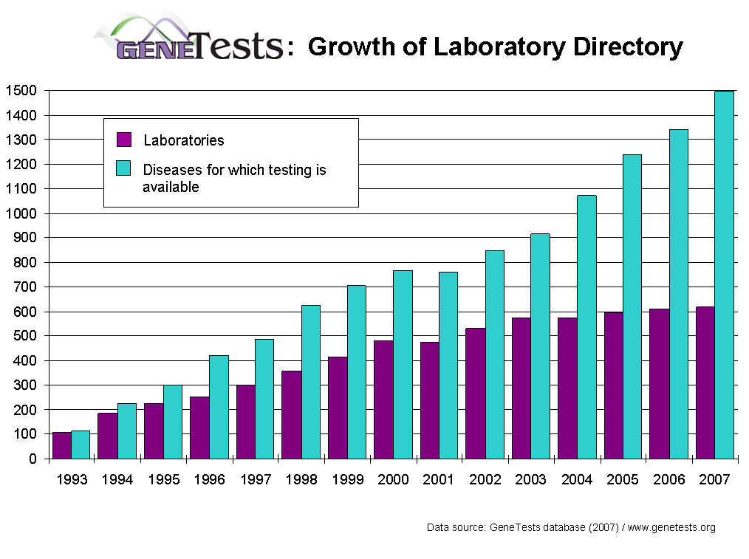

Slide 3
What is Genetic Information?
Information about:
A person’s genetic tests
Genetic tests of a person’s family members
Disease or disorder in a family member
( family history)

Slide 4
What is NOT Genetic Information?
Information about:
Sex or Age
Routine tests such as cholesterol tests
Analysis of infectious agents such as bacteria or viruses, such as HIV.

Slide 5
Prohibitions on Health Insurers:
Discrimination:
1) Prohibits group and individual health insurers from using a person’s genetic information in setting eligibility or premium or contribution amounts.
2) Prohibits group and individual health insurers from considering genetic information as a pre-existing condition.

Slide 6
Prohibitions on Health Insurers:
Privacy:
1) Prohibits health insurers from requesting or requiring that a person undergo a genetic test
2) Prohibits health insurers from asking about genetic information as part of the application process.
3) Once a person is covered, prohibits health insurers from requesting or requiring a person's genetic information for "underwriting purposes" -- for example, to determine whether to raise premiums when an individual renews his or her coverage.

Slide 7
GINA prohibits employment discrimination based on the genetic information of the employee
Applies equally to employers, employment agencies , labor organizations and joint labor-management committees controlling job training
Discrimination includes: “ fail or refuse to hire…discharge.. or otherwise discriminate…with respect to the compensations, terms, conditions, or privileges of employment.”

Slide 8
GINA makes it an unlawful employment practice for an employer to:
“Request, require or purchase genetic information with respect to an employee or family member of an employee”

Slide 9
Exceptions to the prohibition on acquisition of genetic information:
1. Inadvertently request
2. Health or genetic services
3. Genetic monitoring of the biological effects of toxic substances
4. Federal or state FMLA compliance
5. Commercially and publicly available records
6. Law enforcement

Slide 10
GINA prohibits the disclosure of genetic information
Genetic information must be kept as part of the employee confidential medical record

Slide 11
Exceptions to disclosure
1. Written request of the employee
2. Health research
3. In response to a court order
4. FMLA compliance
5. Information of a manifested disease or disorder that poses imminent hazard of death or life threatening illness

Slide 12
GINA Enforcement and Remedies
Consistent with Federal Civil Rights Legislation
EEOC Complaint
Civil Action (After Exhaustion)

Slide 13
Penalties
Same as ADA
Under 15 Employees- Not Covered
15-100 Employees- $50,000
101-200 Employees- $100,000
201-500 Employees- $200,000
Over 500 Employees-$300,000
All Penalties are Maximum
Attorneys fees are recoverable

Slide 14
GINA and State Law
GINA does NOT pre-empt state law
48 states have genetic discrimination in health insurance laws
34 states have genetic discrimination in employment laws

Slide 15
State laws are generally more limited in scope than GINA
For example
1)employer-sponsored health benefit plans are not covered ( Federal)
2) Many state laws have limited definitions of genetic information and do not cover family history.
They may, though, offer a larger potential recovery

Slide 16
State laws covering other forms of genetic discrimination
Life Insurance: 16 states
Disability Ins: 16 states
Long Term Care Ins: 10 states
Several states, such as MA and CA inc protections in all 3 categories
GINA does not address these forms of insurance

Slide 17
Pending State Legislation:
Insurance Discrimination
CA (SB 145)- extends genetic discrimination protections to worker’s compensation
NY( A1769) – extends genetic discrimination protections to life and disability insurance
PA (HB 829)- extends genetic discrimination protections to all forms of insurance
WV (HB 2720)- extends genetic discrimination protections to accident insurance

Slide 18
Pending State Legislation:
Privacy of Genetic Information
Specific written consent required for release of individually identifiable genetic information for purposes other than diagnosis and treatment
CO ( HB 1338)- recently enacted
MD ( HB 12/SB 54)-recently failed
MN(HF 901/902)
MN(HF 1821)-extends to government entities
WV(HB 2720)

Slide 19
The Genetic Information Nondiscrimination Act
“The first civil rights bill of the new century”
-Senator Edward Kennedy

